Slide 1

MES 503 Lab 9
Kayla Blincow, PhD

Slide 2

Announcements
Lab Assignment 2 due tomorrow ☺
Quiz on Wednesday!
  Two-Way ANOVAs + Multiple Linear Regression

Slide 3
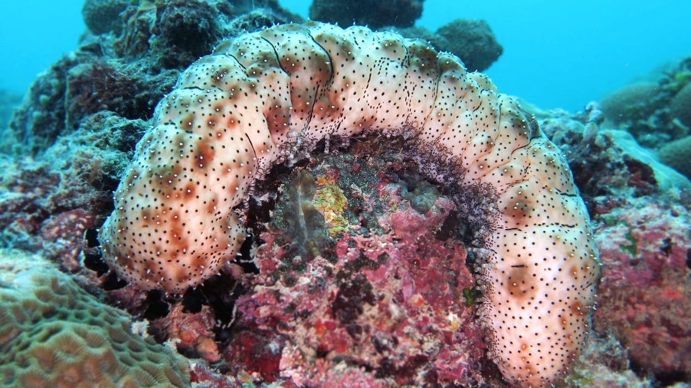

Slide 4
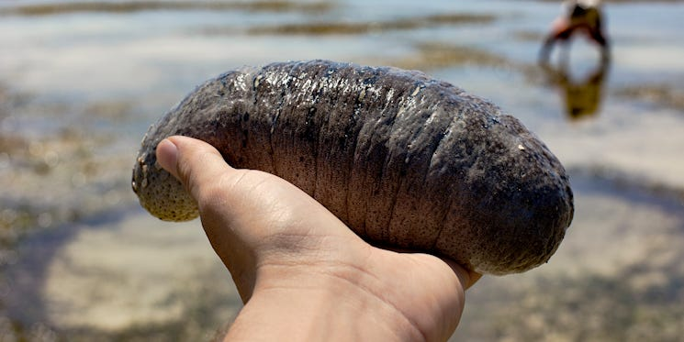
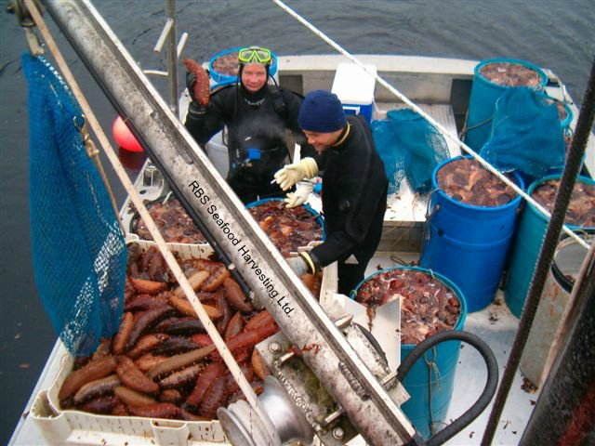
Sea Cucumbers!
Sea cucumbers are overharvested across the globe
They are highly susceptible to overfishing, because they are essentially defenseless to human exploitation and have density dependent reproduction
Highly valuable in Asian markets
One of the most highly trafficked animal products across US-Mexico border

Slide 5

Scenario
We are fisheries biologists that are interested in learning more about the sea cucumber fishery in Indonesia, the world’s top producer of cukes. In particular, we are interested in testing how a suite of variables influence catch per unit effort in cuke fisheries. We survey cucumber fishers and get records of the CPUE across their main fishing grounds.
Our variables of interest are: depth, length of time fisher has been engaged in the fishery, fisher experience metric, region

Slide 6
Switch to ze code!

Slide 7
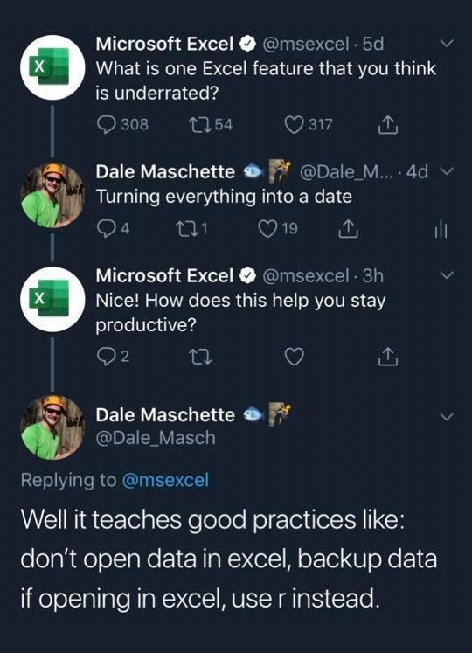
Dates and Times in R

Slide 8
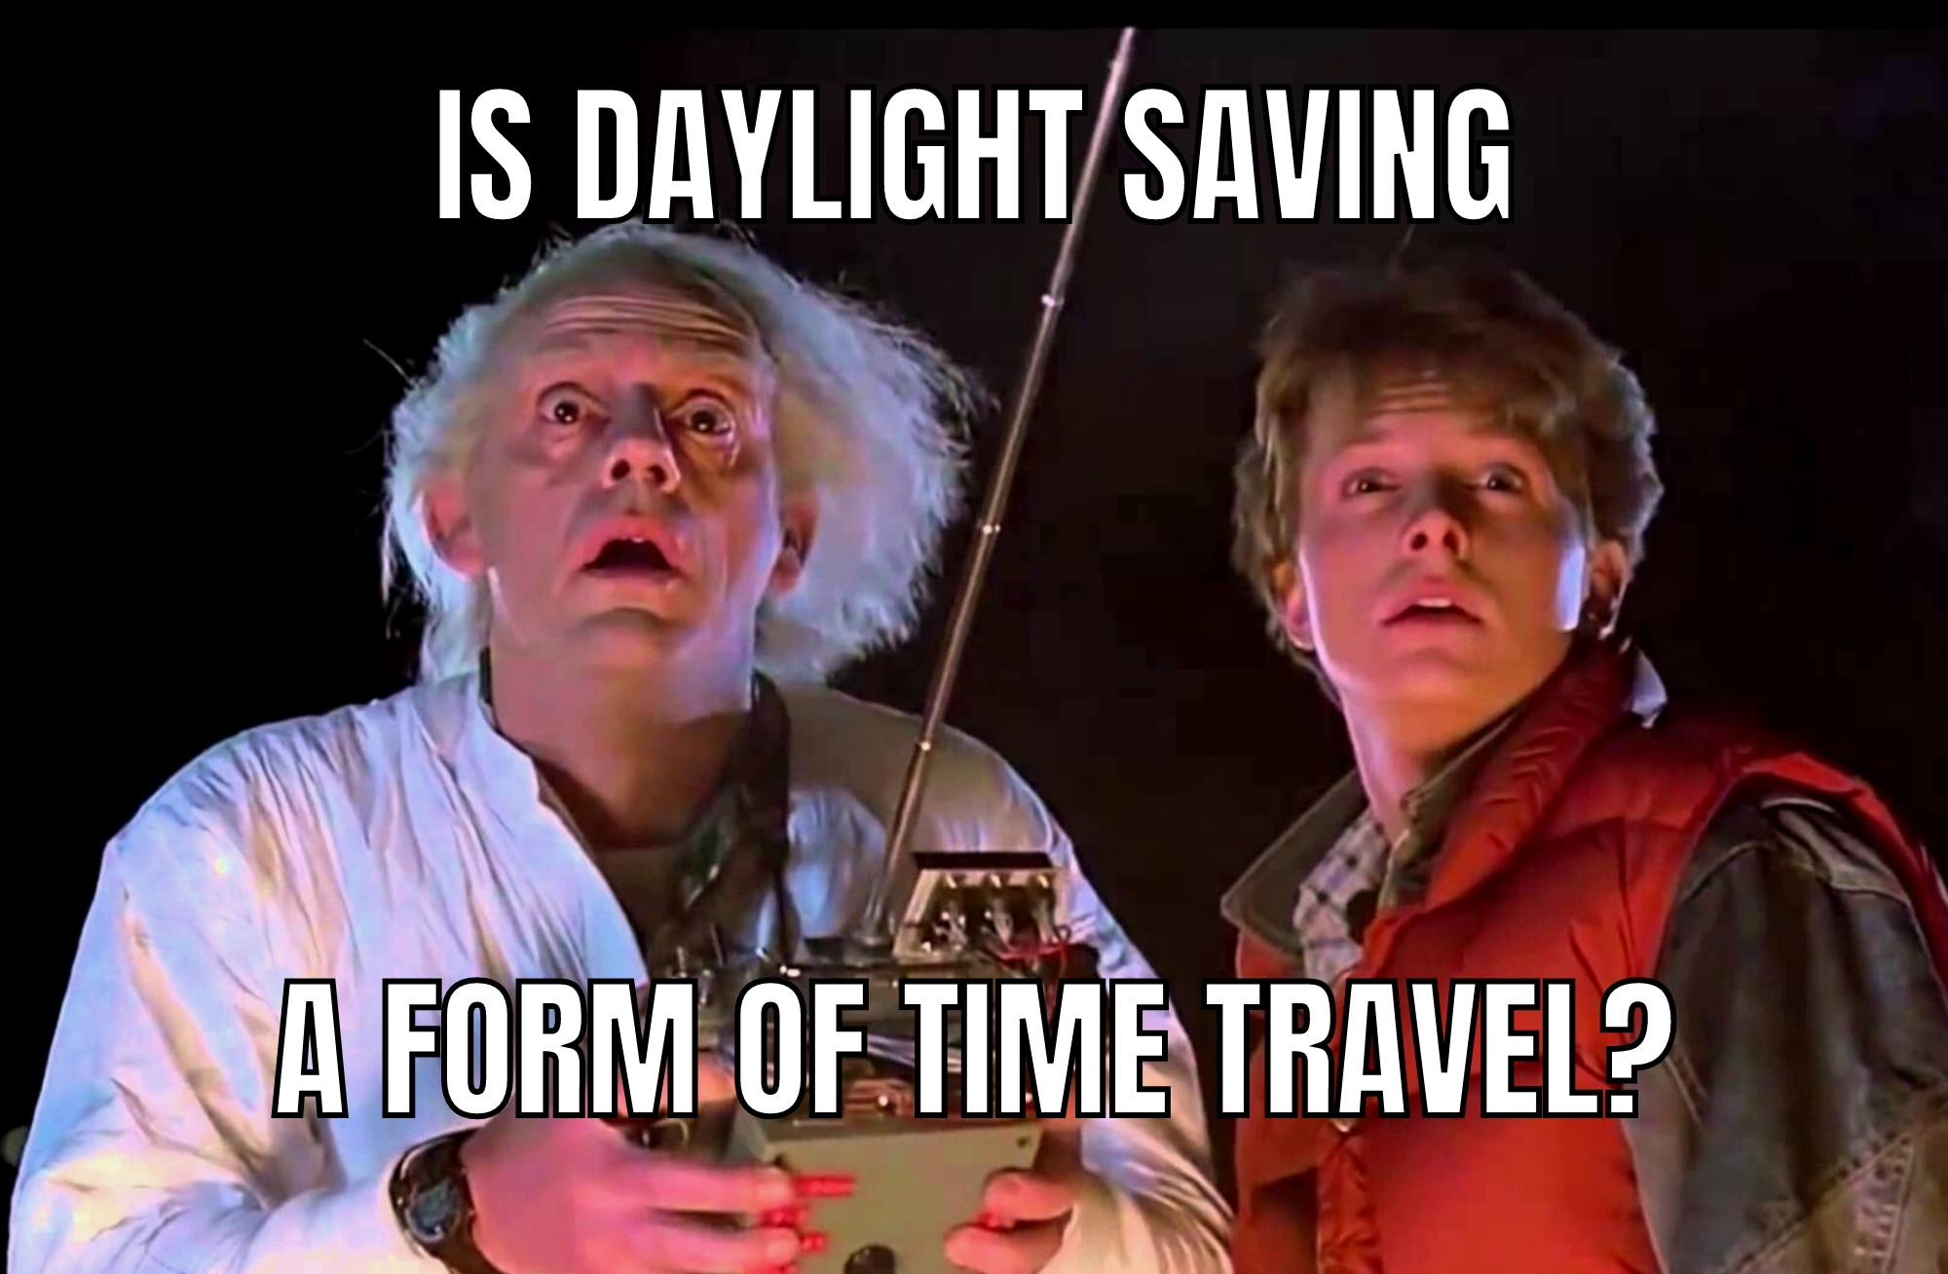
Why dates/times are so gosh darned annoying…
We have imperfect systems for tracking time
Writing dates/times is often ambiguous which is hard for computers
Yet, time is super important for almost all ecological questions!
Notes:
e.g. Not every year has 365 days
Time is a weird mix of social constructs and the earth spinning

Slide 9
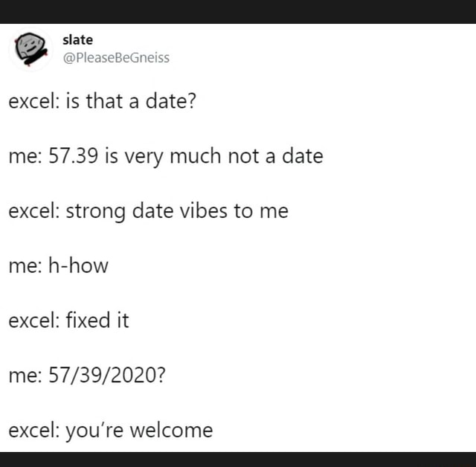
How R handles dates/time.
R will not automatically classify something as a date/time unless you tell it to
  Thank goodness!
Most common date/time classifying functions
  as.Date() – for dates only
  as.POSIXct() – for dates and times
  lubridate package – tidyverse’s answer to date/time issues

Slide 10
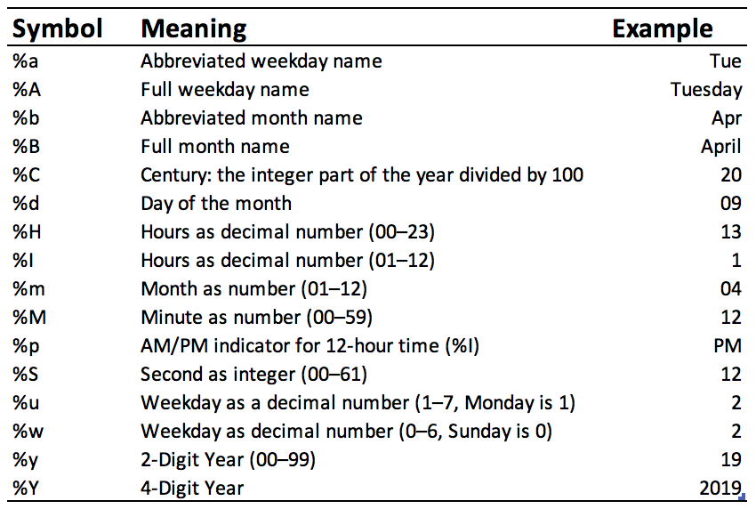

Slide 11

Switch to code!

